Slide 1

Football and COVID: Evaluating the impact of disruptions on public transit accessibility and reliability
Luyu Liu
Department of Geography
The Ohio State University
liu.6544@osu.edu
2022/10/8

Slide 2
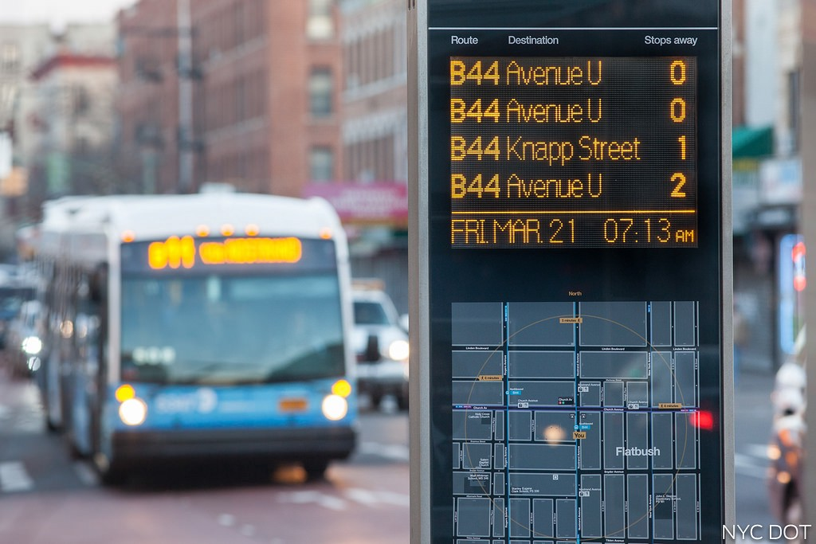
Accessibility, and It Can Be Unreliable
Accessibility is your ability to reach different places
Most accessibility studies use unreliable scheduled data
Expected/scheduled time
Delay: traffic, weather, random disturbances
Real-time data is more reliable
Actual arrival time
High-resolution and high frequency
What users experience
Source

Slide 3
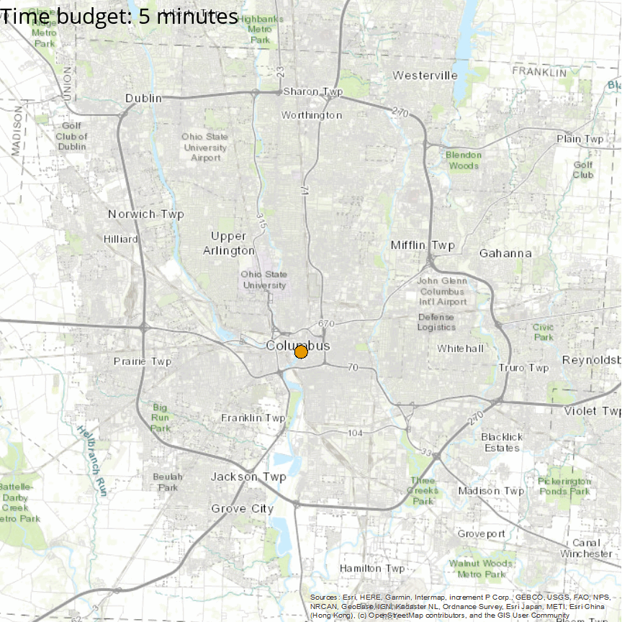
Expectation vs. Reality
How far you can go from Columbus downtown in the real world (orange) versus in the schedule (blue) with different time budgets
Blue: scheduled, expectation from transit authorities and planners
Orange: experienced, reality of passengers
Unreliability: the difference between realizable and scheduled accessibility
Can be influenced by different disruptions

Slide 4
Two Disruptions, Six Years of My Life
Short-term disruption: Ohio State Football Game 2018 – 2019
Create massive traffic around Ohio Stadium
Last about few hours
Do not significantly change the schedule
Long-term disruption: The COVID-19 pandemic 2020 – present
Decrease ridership and cut service
Last about few years
Do significantly change the schedule

Slide 5
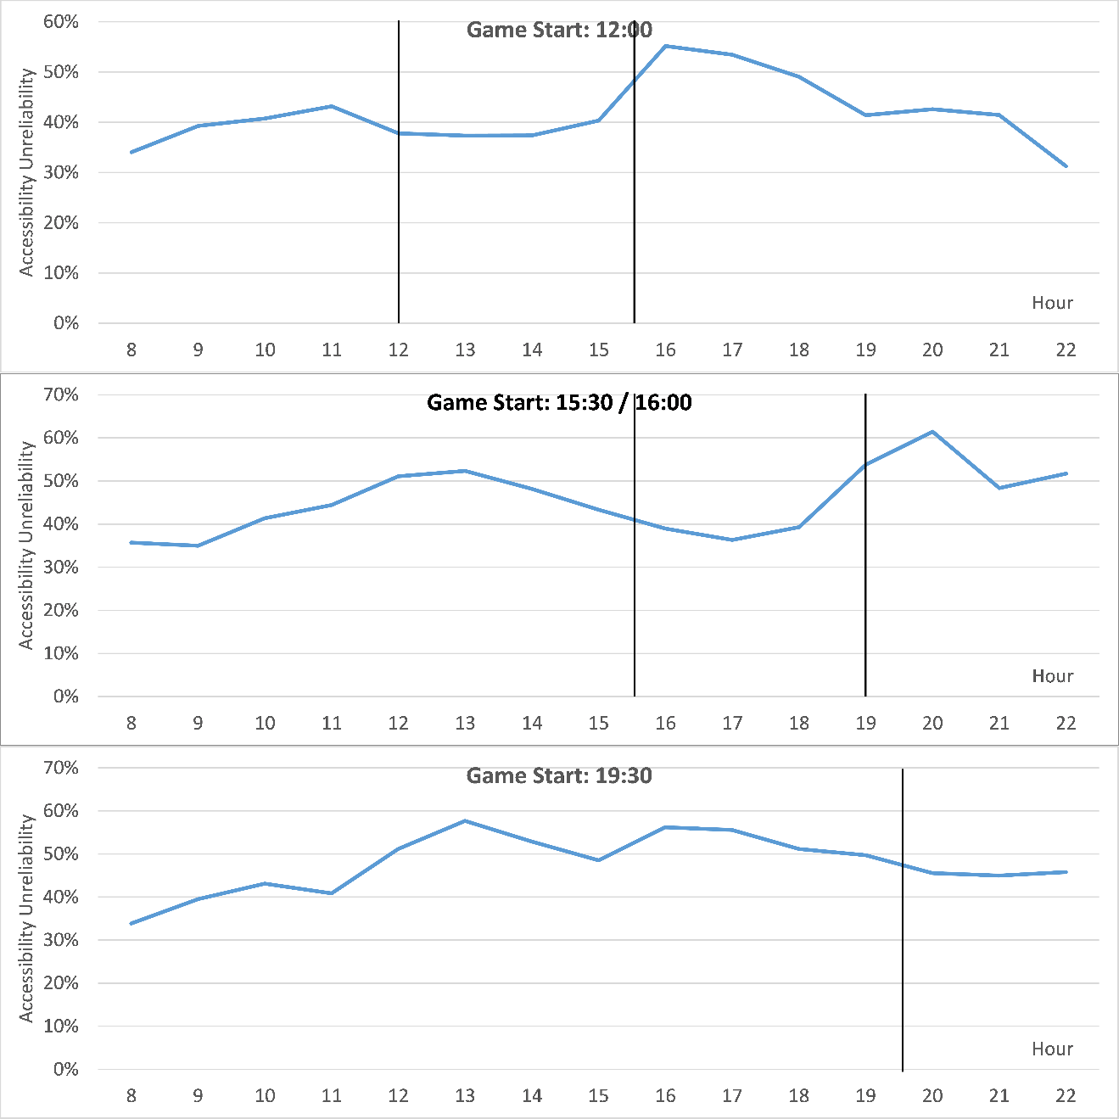
Football: Temporal Pattern
Average hourly profile of unreliability on all 13 OSU football game days
Black lines indicates start and end of each game
Two peaks before and after the game and move with the game start time

Slide 6
Football: Temporal Pattern
Unreliability: home game days > away game days > non-game days
Consistency: for all 13 game days, before-game and after-game unreliability peaks always move with the game time

Slide 7
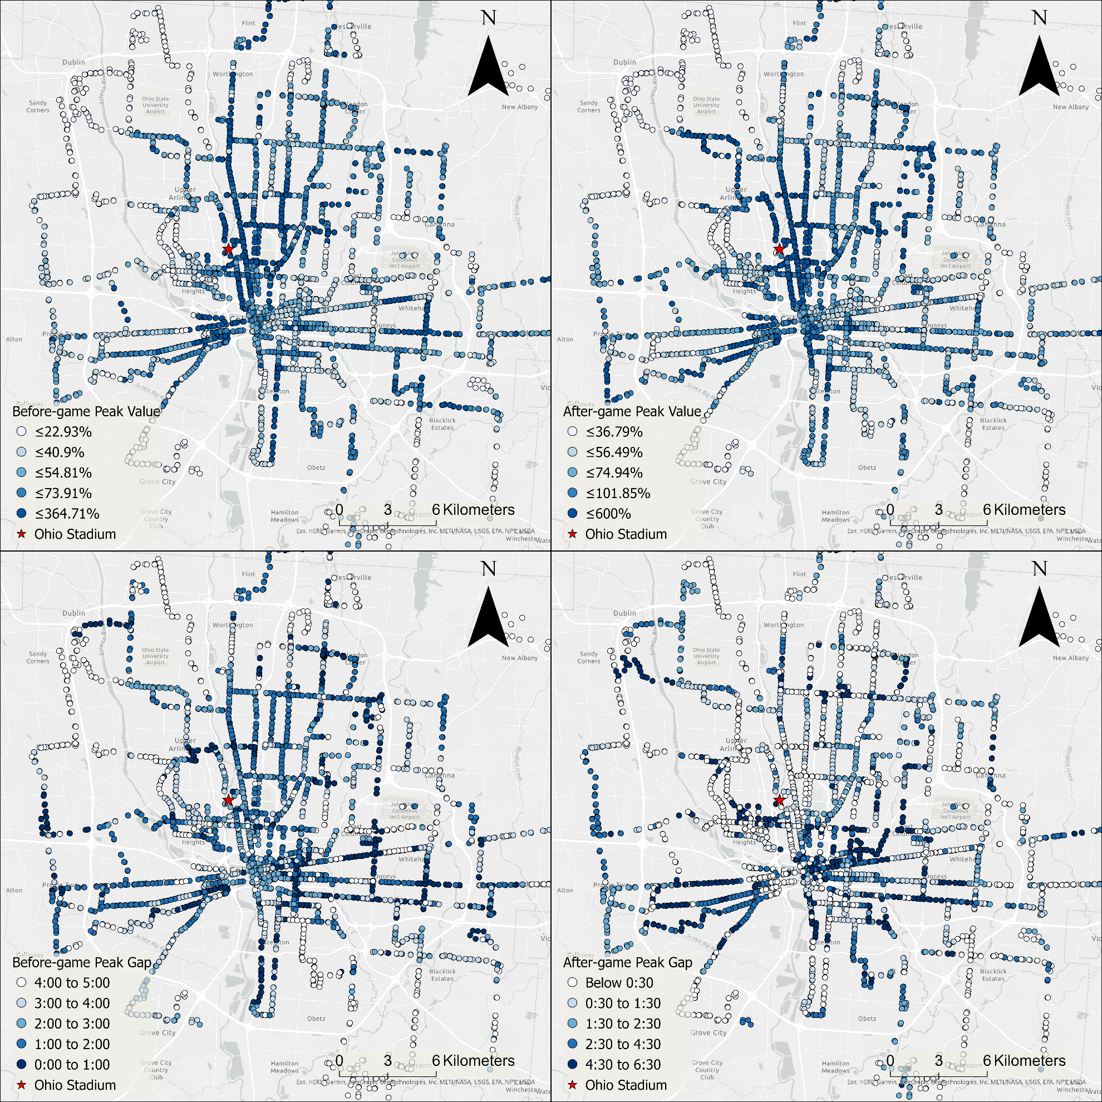
Football: Spatial Patterns
The highest value of unreliability before (up) and after (down) the game
Blue: more unreliable
White: more reliable
High cluster around Ohio Stadium
Strongly suggest the link between football and unexpectedly high unreliability

Slide 8
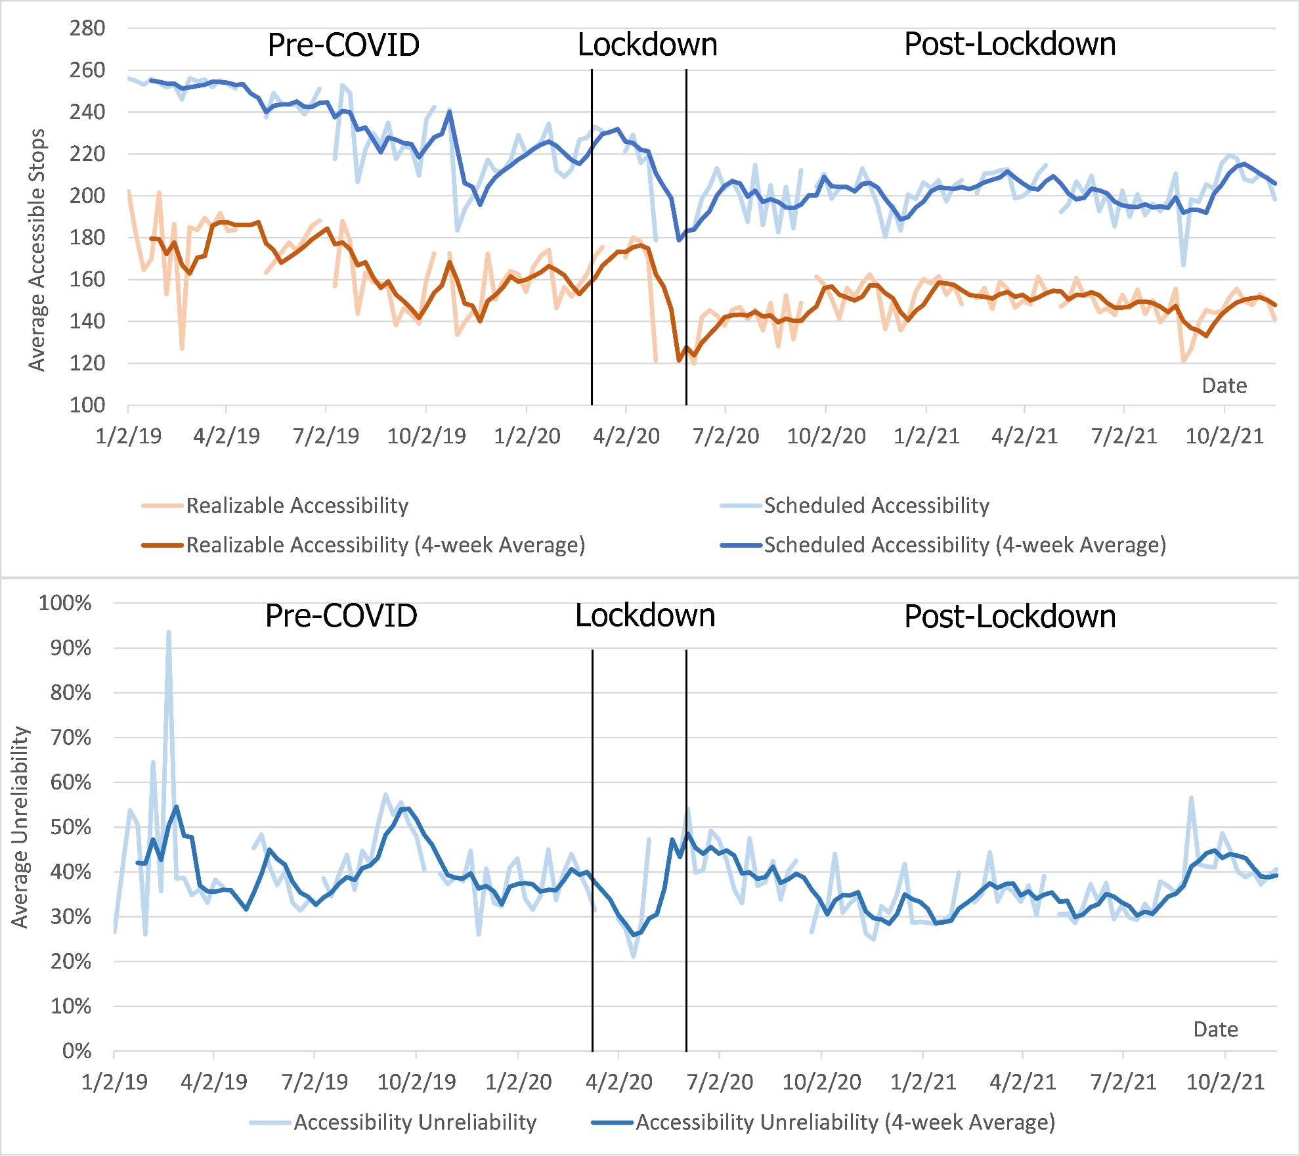
COVID-19: Temporal Pattern of Accessibility
Trend of accessibility from 2019 to 2021
Higher accessibility is better
Accessibility plunged during lockdown with service cut
Accessibility still stayed down after lockdown in 2021

Slide 9
COVID-19: Temporal Pattern of Unreliability
Trend of unreliability from 2019 to 2021
Higher unreliability is worse
During lockdown
First decreased: road condition became better
Then increased: service cut

Slide 10
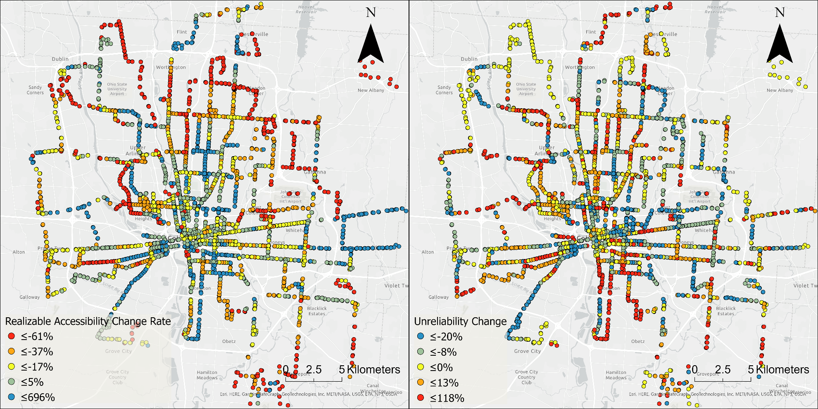
COVID-19: Spatial Pattern
The change of accessibility and unreliability
Red means more negative impact
Blue means less negative impact
Downtown and urban areas are less impacted, even experience improvement
Service cut is the primary factor for performance loss

Slide 11
Conclusion
Schedule-based accessibility is unreliable
OSU football games have significant impacts on the performance of public transit
COVID-19 have persistent negative impacts on both accessibility and reliability
Unreliability must be considered in tandem with other measures, such as accessibility, to understand system performance holistically

Slide 12



Thank you!
Contact
Luyu Liu: liu.6544@osu.edu
Adam Porr: aporr@morpc.org
Harvey Miller: miller.81@osu.edu

